Slide 1
Software Engineering with Project Management
Introduction & Process Models
Dr.Sachin Bojewar

Slide 2
Introduction
What is Software?
The product that software professionals build and then support over the long term.
Software involves:
(1) instructions (computer programs) that when executed provide desired features, function, and performance;
(2) data structures that enable the programs to store and manipulate information and
(3) documentation that describes the operation and use of the programs.

Slide 3
What is Software engineering?
Software engineering is the study and an application of engineering to the design , development and maintenance of software.
The discipline of software engineering was created
to address poor quality of software,
get projects exceeding time and budget under control,
and ensure that software is built systematically, rigorously, measurably, on time, on budget, and within specification.

Slide 4
Essential attributes of good software
Product characteristic | Description
Maintainability | It should be written in such a way so that it can progress to meet the changing needs of customers. This is a critical attribute because software change is an inevitable requirement of a changing business environment.
Dependability and security | Software dependability includes a range of characteristics including reliability, security and safety. Dependable software should not cause physical or economic damage in the event of system failure. Malicious users should not be able to access or damage the system.
Efficiency | Software should not make wasteful use of system resources such as memory and processor cycles. Efficiency therefore includes responsiveness, processing time, memory utilisation, etc.
Acceptability | Software must be acceptable to the type of users for which it is designed. This means that it must be understandable, usable and compatible with other systems that they use.

Slide 5
Software Process
A process is a collection of activities, actions and tasks that are performed when some work product is to be created.
Purpose of process is to deliver software in a timely manner and with sufficient quality to satisfy those who have sponsored its creation and those who will use it.

Slide 6
Five Activities of a Generic Process framework
Communication: communicate with customer to understand objectives and gather requirements
Planning: creates a “map” defines the work by describing the tasks, risks and resources, work products and work schedule.
Modeling: Create a “sketch”,what it looks like architecturally, how the essential parts fit together and other characteristics.
Construction: code generation and the testing.
Deployment: Delivered to the customer who evaluates the products and provides feedback based on the evaluation.

Slide 7
These five framework activities can be used to all software development irrespective of the application domain, size of the project, complexity of the efforts etc.
For many software projects, these framework activities are applied iteratively as a project progresses.
Each iteration produces a software increment that provides a subset of overall software features and functionality.

Slide 8
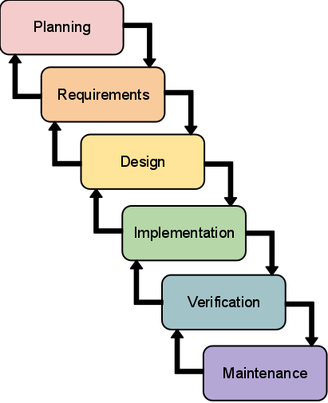
Software Development Life Cycle

Slide 9
1.Requirement gathering and analysis
Business requirements are gathered in this phase.
Meetings with managers, stake holders and users are held in order to determine the requirements like;
Who is going to use the system?
How will they use the system?
What data should be input into the system?
What data should be output by the system?
These are general questions that get answered during a requirements gathering phase.

Slide 10
After requirement gathering these requirements are analyzed for their validity and the possibility of incorporating the requirements in the system is checked.
Finally, a Requirement Specification document [SRS] is created which serves the purpose of guideline for the next phase of the model.

Slide 11
2.Design
In this phase the SYSTEM and SOFTWARE DESIGN is prepared from the requirement specifications which were studied in the first phase.
System Design helps in specifying hardware and system requirements and also helps in defining overall system architecture.
The system design specifications serve as input for the next phase of the model.

Slide 12
3. Implementation / Coding
On receiving system design documents, the work is divided in modules/units and actual coding is started.
Since, in this phase the code is produced so it is the main focus for the developer.
This is the longest phase of the software development life cycle.

Slide 13
4.Verification / Testing
After the code is developed it is tested against the requirements to make sure that the product is actually solving the needs gathered during the requirements phase.
During this phase unit testing, integration testing, system testing, acceptance testing etc. are done.

Slide 14
5.Deployment
After successful testing the product is delivered / deployed to the customer for their use.

Slide 15
6.Maintenance
Once when the customers starts using the developed system then the actual problems comes up and needs to be solved from time to time.
This process where the care is taken for the developed product is known as maintenance.

Slide 16
SDLC models
There are various Software development models or methodologies.
Waterfall model
RAD model
Iterative model
Incremental model
Spiral model
Prototype model

Slide 17
Waterfall model
The Waterfall Model was first Process Model to be introduced.
It is also referred to as a linear-sequential life cycle model.
It is very simple to understand and use
In this each phase must be completed fully before the next phase can begin.
This type of model is basically used for the for the project which is small and there are no uncertain requirements.

Slide 18
Used when requirements are well understood and risk is low
best understood by upper management
In this model the testing starts only after the development is complete.
In waterfall model phases do not overlap.

Slide 19
Waterfall Model
Communication
Project initiation
Requirements gathering
Planning
Estimating
Scheduling
Tracking
Modeling
Analysis
Design
Construction
Code
Test
Deployment
Delivery
Support
Feedback

Slide 20
Waterfall Model(Problems)
Doesn't support iteration, so changes can cause confusion
Difficult for customers to state all requirements explicitly and up front
Requires customer patience because a working version of the program doesn't occur until the final phase
Problems can be somewhat improved in the model through the addition of feedback loops

Slide 21
Waterfall Model with Feedback (Diagram)
Communication
Project initiation
Requirements gathering
Planning
Estimating
Scheduling
Tracking
Modeling
Analysis
Design
Construction
Code
Test
Deployment
Delivery
Support
Feedback

Slide 22
Advantages of Waterfall model
Easy to understand, easy to use
• Provides structure to inexperienced staff
• Sets requirements stability
• Good for management control (plan, staff, track)
• Works well when quality is more important than cost or schedule

Slide 23
Disadvantages of Waterfall model
All requirements must be known upfront
Can give a false impression of progress
Does not reflect problem-solving nature of software development
Integration is one big bang at the end
Little opportunity for customer to preview the system (until it may be too late)

Slide 24
When to use the Waterfall Model.
• Requirements are very well known
• Product definition is stable
• Technology is understood
The project is short.
• New version of an existing product
• Porting an existing product to a new platform.

Slide 25
Incremental model
In incremental model the whole requirement is divided into various builds.
Multiple development cycles take place here, making the life cycle a“multi-waterfall” cycle.
Cycles are divided up into smaller, more easily managed modules.
Each module passes through the requirements, design, implementation and testing phases.

Slide 26
Incremental model
A working version of software is produced during the first module, so you have working software early on during the software life cycle.
Each subsequent release of the module adds function to the previous release. The process continues till the complete system is achieved.

Slide 27
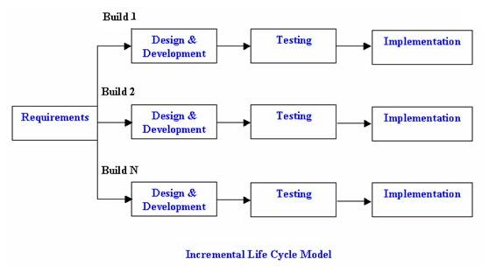
Incremental model

Slide 28
Advantages of Incremental model:
Generates working software quickly and early during the software life cycle.
This model is more flexible – less costly to change scope and requirements.
It is easier to test and debug during a smaller iteration.
In this model customer can respond to each built.
Lowers initial delivery cost.
Easier to manage risk because risky pieces are identified and handled during iteration.

Slide 29
Disadvantages of Incremental model
Needs good planning and design.
Needs a clear and complete definition of the whole system before it can be broken down and built incrementally.
Total cost is higher than waterfall.

Slide 30
When to use the Incremental model
This model can be used when the requirements of the complete system are clearly defined and understood.
Major requirements must be defined; however, some details can evolve with time.
There is a need to get a product to the market early.
A new technology is being used
Resources with needed skill set are not available
There are some high risk features and goals.

Slide 31
Iterative model
An iterative life cycle model does not attempt to start with a full specification of requirements.
Instead, development begins by specifying and implementing just part of the software, which can then be reviewed in order to identify further requirements.
This process is then repeated, producing a new version of the software for each cycle of the model.

Slide 32
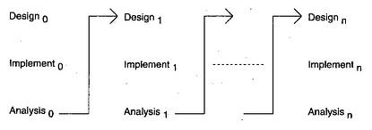

Slide 33
Advantages of Iterative model
In iterative model we are building and improving the product step by step. Hence we can track the defects at early stages. This avoids the downward flow of the defects.
In iterative model we can get the reliable user feedback. When presenting sketches and blueprints of the product to users for their feedback, we are effectively asking them to imagine how the product will work.
In iterative model less time is spent on documenting and more time is given for designing.

Slide 34
Disadvantages of Iterative model
Each phase of an iteration is rigid with no overlaps
Costly system architecture or design issues may arise because not all requirements are gathered up front for the entire lifecycle

Slide 35
When to use iterative model
Requirements of the complete system are clearly defined and understood.
When the project is big.
Major requirements must be defined; however, some details can evolve with time.

Slide 36

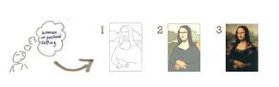
Incremental model
Iterative model

Slide 37
RAD model
Rapid Application Development (RAD) is an incremental software development process model which is a “high-speed” adaptation of the linear sequential model in which rapid development is achieved by using component-based construction.
If requirements are well understood and project scope is constrained, the RAD process enables a development team to create a “fully functional system” within very short time periods, such as in 60 to 90 days.

Slide 38
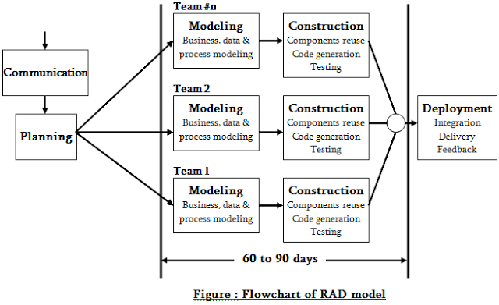
RAD model

Slide 39
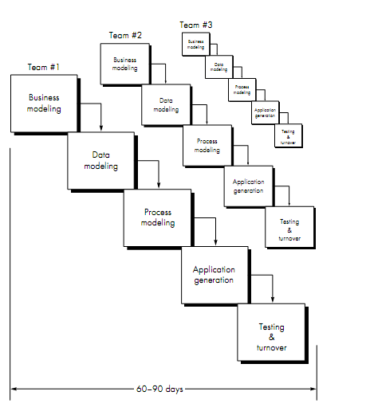

Slide 40
Business modeling: The information flow is identified between various business functions.
Data modeling: Information gathered from business modeling is used to define data objects that are needed for the business.
Process modeling: Data objects defined in data modeling are converted to achieve the business information flow to achieve some specific business objective. Description are identified and created for CRUD of data objects.

Slide 41
Application generation: Automated tools are used to convert process models into code and the actual system.
Testing and turnover: Test new components and all the interfaces.

Slide 42
Advantages of the RAD model
Reduced development time.
Increases reusability of components
Quick initial reviews occur
Encourages customer feedback
Integration from very beginning solves a lot of integration issues

Slide 43
Disadvantages of RAD model
Depends on strong team and individual performances for identifying business requirements.
Only system that can be modularized can be built using RAD
Requires highly skilled developers/designers.
High dependency on modeling skills
Inapplicable to cheaper projects as cost of modeling and automated code generation is very high.

Slide 44
When to use RAD model
RAD should be used when there is a need to create a system that can be modularized in 2-3 months of time.
It should be used if there’s high availability of designers for modeling and the budget is high enough to afford their cost along with the cost of automated code generating tools.
RAD SDLC model should be chosen only if resources with high business knowledge are available and there is a need to produce the system in a short span of time (2-3 months).

Slide 45
Spiral model
The spiral model is similar to the incremental model, with more emphasis placed on risk analysis.
The spiral model has four phases: Planning, Risk Analysis, Engineering and Evaluation.
A software project repeatedly passes through these phases in iterations (called Spirals in this model).
The baseline spiral, starting in the planning phase, requirements are gathered and risk is assessed. Each subsequent spirals builds on the baseline spiral.

Slide 46
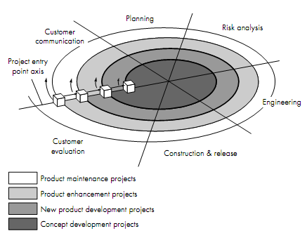

Slide 47
Customer communication—tasks required to establish effective communication between developer and customer.
Planning—tasks required to deﬁne resources, timelines, and other project related information.
Risk analysis—tasks required to assess both technical and management risks.
Engineering—tasks required to build one or more representations of the application.
Construction and release—tasks required to construct, test, install, and provide user support (e.g., documentation and training).

Slide 48
Advantages of Spiral model
High amount of risk analysis hence, avoidance of Risk is enhanced.
Good for large and mission-critical projects.
Strong approval and documentation control.
Additional Functionality can be added at a later date.
Software is produced early in the software life cycle.

Slide 49
Disadvantages of Spiral model
Can be a costly model to use.
Risk analysis requires highly specific expertise.
Project’s success is highly dependent on the risk analysis phase.
Doesn’t work well for smaller projects.

Slide 50
When to use Spiral model
When costs and risk evaluation is important
For medium to high-risk projects
Long-term project commitment unwise because of potential changes to economic priorities
Users are unsure of their needs
Requirements are complex
New product line
Significant changes are expected (research and exploration)

Slide 51
Prototype model
The basic idea here is that instead of freezing the requirements before a design or coding can proceed, a throwaway prototype is built to understand the requirements.
This prototype is developed based on the currently known requirements.
By using this prototype, the client can get an “actual feel” of the system, since the interactions with prototype can enable the client to better understand the requirements of the desired system.

Slide 52
Prototype model
Prototyping is an attractive idea for complicated and large systems for which there is no manual process or existing system to help determining the requirements.
The prototype are usually not complete systems and many of the details are not built in the prototype. The goal is to provide a system with overall functionality.

Slide 53
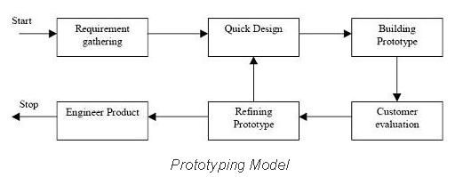
Prototype model

Slide 54
Quick Planning
Communication
Start
Modeling
Quick Design
Deployment,
Delivery,
and Feedback
Construction
Of Prototype

Slide 55
Advantages of Prototype model
Users are actively involved in the development
Since in this methodology a working model of the system is provided, the users get a better understanding of the system being developed.
Errors can be detected much earlier.
Quicker user feedback is available leading to better solutions.
Missing functionality can be identified easily
Confusing or difficult functions can be identified Requirements validation, Quick implementation of, incomplete, but functional, application.

Slide 56
Disadvantages of Prototype model
Leads to implementing and then repairing way of building systems.
Practically, this methodology may increase the complexity of the system as scope of the system may expand beyond original plans.
Incomplete application may cause application not to be used as the full system was designed Incomplete or inadequate problem analysis.

Slide 57
When to use Prototype model
prototype model should be used when the desired system needs to have a lot of interaction with the end users.
Typically, online systems, web interfaces have a very high amount of interaction with end users, are best suited for Prototype model.
Prototyping ensures that the end users constantly work with the system and provide a feedback which is incorporated in the prototype to result in a useable system.
They are excellent for designing good human computer interface systems.

Slide 58
Specialized process models
Specialized process models take on many of the characteristics of one or more of the traditional models
Specialized process models are applied when narrowly defined engineering approach is chosen
Specialized process models are as follows
Component based development model
The formal method model
Aspect –oriented software development

Slide 59
Component based development model
The component-based development model incorporates many of the characteristics of the spiral model.
It is evolutionary in nature ,includes an iterative approach to the creation of software.
However, the component-based development model constructs applications from prepackaged software components,
i.e from existing software modules
Important feature of component based model is that , it leads to ‘software reuse’.

Slide 60
Modeling and construction activities begin with the identification of candidate components.
These components can be designed as either conventional software modules or object-oriented classes or packages of classes.
Component is independent and replaceable part of system
Package of classes is a collection of objects that work together to achieve results

Slide 61
the component-based development model incorporates the following steps
Available component-based products are researched and evaluated for the application domain.
Component integration issues are considered.
A software architecture is designed to accommodate the components.
Components are integrated into the architecture.
testing is conducted to ensure proper functionality.

Slide 62
Disadvantages
Advantages
Supports reusability
Therefore reduction in development time
Reduces overall costs
Increase in productivity
Late discovery of errors
Problem in encapsulation
Difficult to find in which component a particular function will be implemented
Difficult to achieve a complete separation of process from component

Slide 63
Formal method model
The formal methods model encompasses a set of activities that leads to formal mathematical specification of computer software.
Formal methods enable you to specify, develop, and verify a computer-based system by applying a rigorous, mathematical notation.
A variation on this approach, called cleanroom software engineering is currently applied by some software development organizations

Slide 64
Advantages:
When formal methods are used during development, they provide a mechanism for eliminating many of the problems that are difficult to overcome using other software engineering paradigms.
Ambiguity, incompleteness, and inconsistency can be discovered and corrected more easily
When formal methods are used during design, they serve as a basis for program verification and therefore enable you to discover and correct errors that might otherwise go undetected.

Slide 65
Disadvantages
The development of formal models is currently quite time consuming and expensive.
Because few software developers have the necessary background to apply formal methods, extensive training is required.
It is difficult to use the models as a communication mechanism for technically unsophisticated customers.

Slide 66
Aspect oriented Software Development
Irrespective of the software process that is chosen, the builders of complex software regularly implement a set of localized features, functions, and information content.
These localized software characteristics are modeled as components (e.g., object oriented classes) and then constructed within the context of a system architecture.
As modern computer-based systems become more sophisticated and complex.

Slide 67
Certain concerns—customer required properties or areas of technical interest
Some concerns are high-level properties of a system (e.g., security, fault tolerance).
Other concerns affect functions (e.g., the application of business rules), while others are systemic (e.g., task synchronization or memory management).
When concerns cut across multiple system functions, features, and information, they are often referred to as crosscutting concerns.

Slide 68
Aspectual requirements define those crosscutting concerns that have an impact across the software architecture.
Aspect-oriented software development (AOSD), often referred to as aspect-oriented programming (AOP), is a relatively new software engineering paradigm that provides a process and methodological approach for defining, specifying, designing, and constructing aspects
The evolutionary model is appropriate as aspects are identified and then constructed.

Slide 69
The parallel nature of concurrent development is essential because aspects are engineered independently of localized software components and yet, aspects have a direct impact on these components.
Hence, it is essential to instantiate asynchronous communication between the software process activities applied to the engineering and construct ion of aspects and components.

